Slide 1
MARKETING AND RETAIL ANALYTICS – MILESTONE - 2
B
M
A
R
K
E
T
S
K
E
I
S
S
T
Y
L
SUBMITTED BY -THILAK-
A
N
A
Post Graduate Diploma in Data Science and Business Analytics – AUG 2021

Slide 2
Table of content
03
Problem statement
MBA
17
04
Aim of Project
18
RFM – Workflow Image
05-07
About Data
RFM – Filtered Data
19
08
EDA - Univariate
RFM – Group By
20
09
EDA – Trend across year
RFM – Cell Splitter
21
10
EDA – Trend across Qtr
RFM – Associate Rule
22
11
EDA – Trend across month
RFM – Inference
23
12-14
EDA – Year. Wise Trend
RFM – Recommendation
23

Slide 3
Problem Statement
A Grocery Store shared the transactional data with you. Your job is to identify the most popular combos that can be suggested to the Grocery Store chain after a thorough analysis of the most commonly occurring sets of menu items in the customer orders. The Store doesn’t have any combo meals. Can you suggest the best combo meals

Slide 4
Aim of the project
We aim to analyze the association rules to suggest the best combo and offers for the Grocery Store using Market Basket Analysis.
Assuming the data provided in the csv file is from Point of Sale (POS).

Slide 5
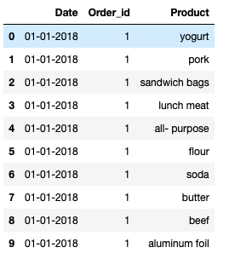
About Data
Preview of the Data Shape of the Data:
No. of rows : 20641
No. of columns : 3

Slide 6
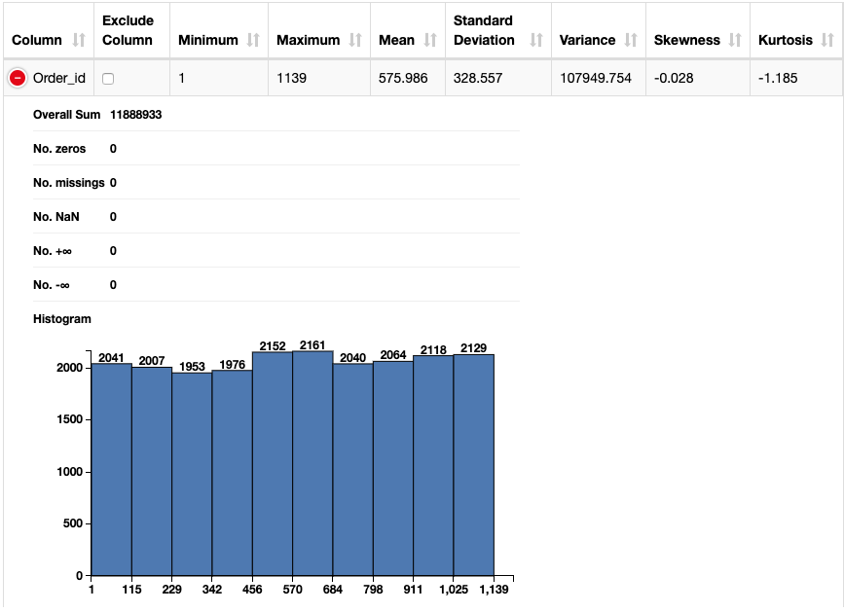
About Data
Info of the Data
Summary of the data by using data explorer node:
It shows us that there is NO missing
values,
NO null values
Minimum order number is 1
Maximum order number is 1139.
and it also shows the standard deviation,
skewness, variance, no. of
zeros present in dataset along with the
histogram.

Slide 7
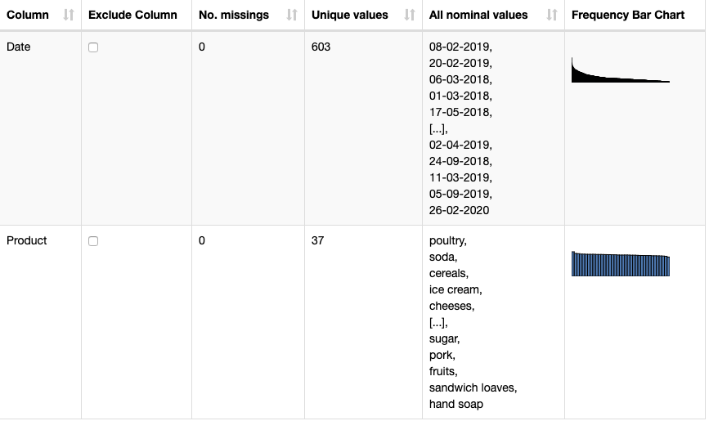
About Data
Info of the Data
Summary of the data by using data explorer node:
We can observe Product has 37
unique products (poultry,
soda, cereals, Ice cream,cheeses etc.)
Date contains 603 unique products (lets say customer repeatedly purchased different product with different order ID’s).

Slide 8
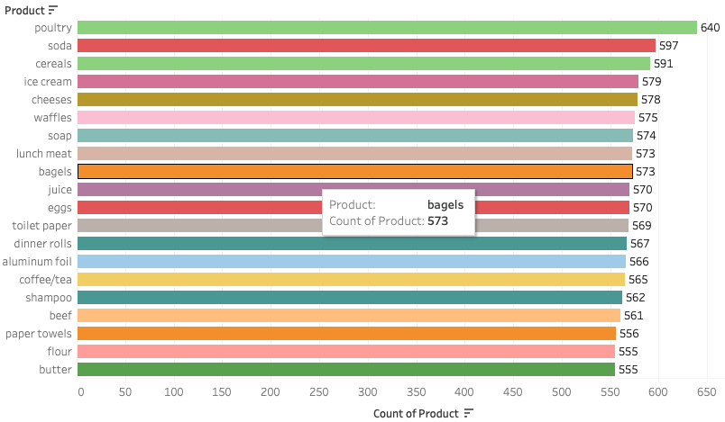
EDA
Univariate Analysis
Insights:
We can observe that there is high demand for Poultry products followed by Soda, cereals, Ice cream
However, the demand for sandwiches and sandwich lovers is very less.

Slide 9
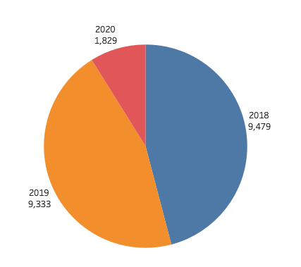
EDA- Trend across Year
Univariate Analysis
Insights:
In 2018 and 2019 there is very high demand of all products because these are eatables items.
However, in 2020, the demand falls drastically for all items because of coronavirus pandemic and therefore hits the sales in downfall trend

Slide 10
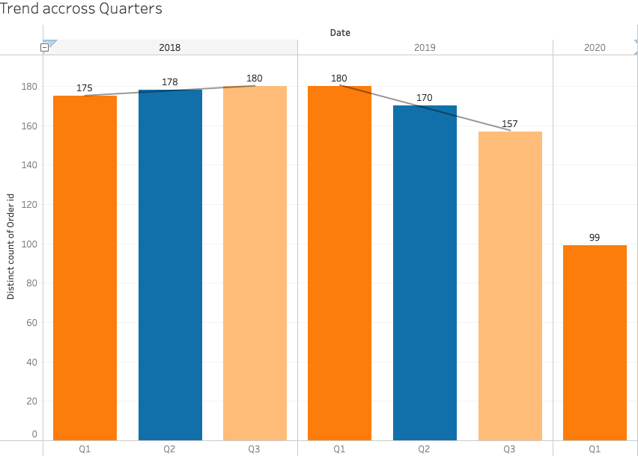
EDA- Tend across quarters
Univariate Analysis
Insights:
The Q3 2018 and Q1 2019 and have the highest no of sales (180)
The lowest no of Sales spotted in Q1 2020
Which says, the early periods of Pandemic, Sales went downfall.

Slide 11
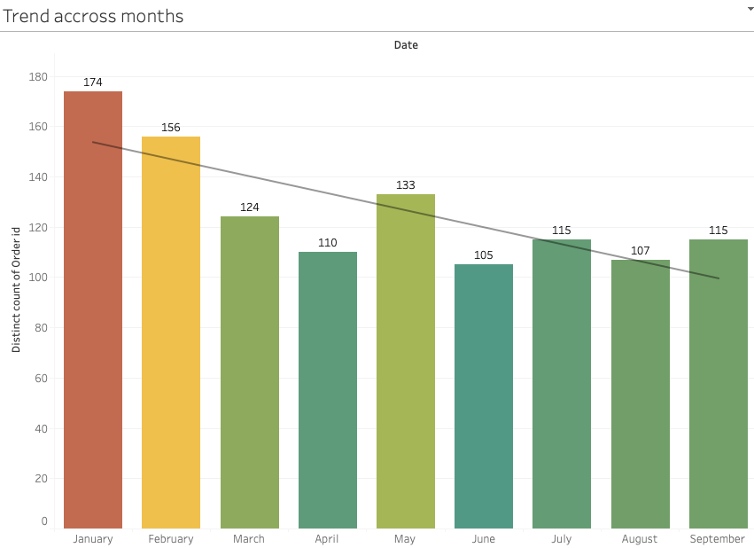
EDA – Trend across months
Insights:
There is highest purchases happened in Jan(174) and low purchases happened in June(105), followed by April (110).
Eventually shows the Sales went downward trend based on Month-wise.

Slide 12
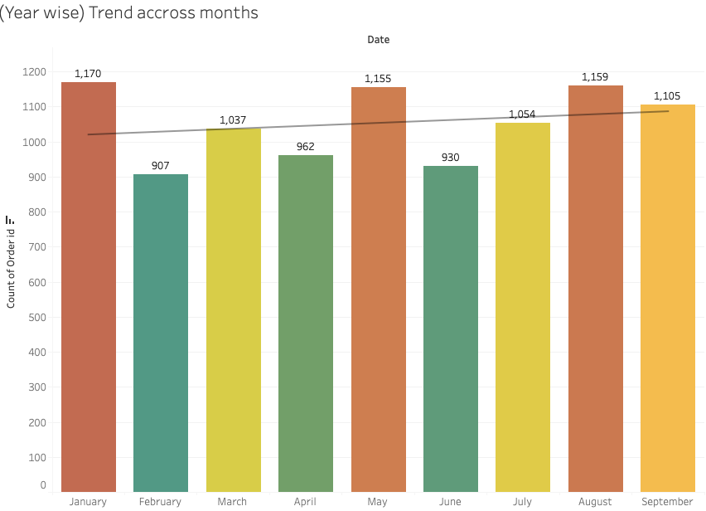
EDA – Year-wise trend(2018).
Insights: (2018)
Highest number of Purchases Happened in starting of all Quarters in the year 2018.

Slide 13
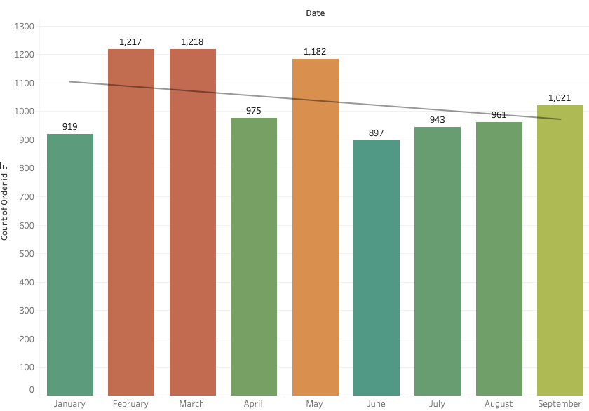
EDA – Year-wise trend(2019).
Insights: (2019)
Highest number of Purchases Happened in February, March and May in the year 2019.
And the sales still in downward trend.

Slide 14
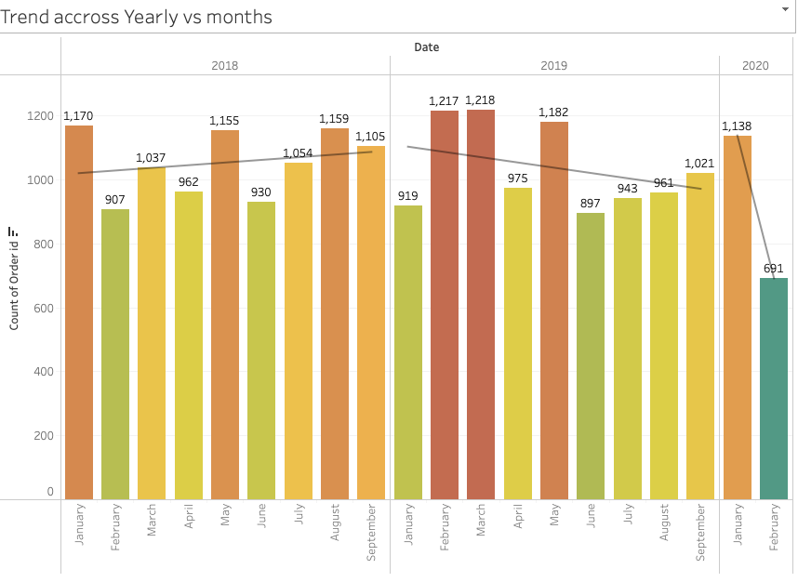
EDA – Overall Year-wise trend.

Slide 15
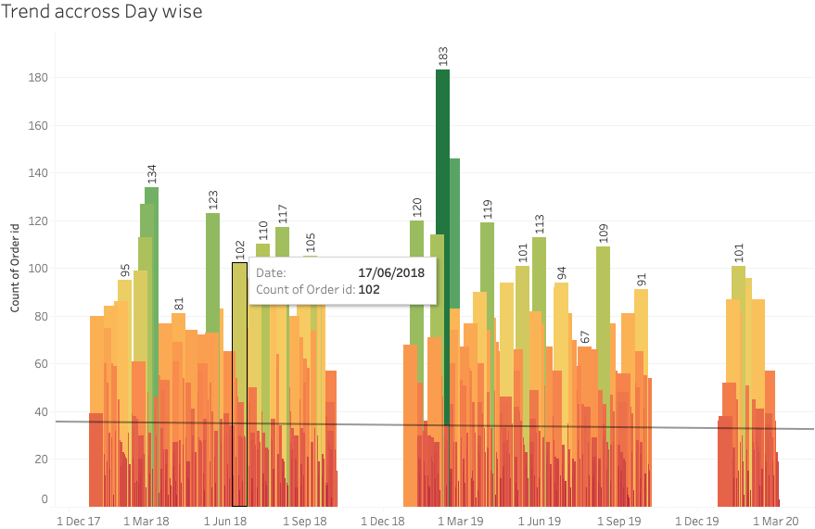
EDA –Trend across Day.
Trend Across Day
Highest number of Purchases Happened in 1st March and Odd Months in 2018 & 2019 trend.

Slide 16
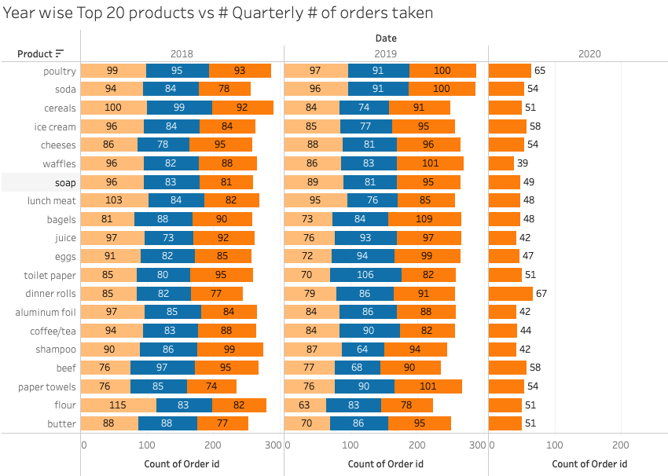
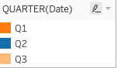
EDA –Number of purchases in each quarter.

Slide 17
Market Basket Analysis
MBA is a data mining technique that is used to uncover purchase patterns in any retail setting. The goal of Market Basket Analysis is to understand consumer behaviour by identifying relationships between the items that people buy.
How does market basket analysis work?
The Amazon website employs a well-known example of market basket analysis. On a product page, Amazon presents users with related products, under the headings of “Frequently bought together” and “Customers who bought this item also bought.
Performing Market Basket Analysis
How does market basket analysis work?
Market Basket Analysis is modelled on Association rule mining, i.e., the IF {}, THEN {} construct. For example, IF a customer buys bread, THEN he is likely to buy butter as well
The association rule has three
measures that express the degree of confidence in the rule,
Support (X), Confidence (Y), and Lift
Lift (X -> Y) = 1 : No correlation within the itemset.
Lift (X -> Y) > 1: Positive correlation within the itemset, i.e., X and Y, are likely to be bought together.
Lift (X -> Y) < 1: Negative correlation within the itemset, i.e., X and Y, are unlikely to be bought together.
Algorithms that use association mining include AIS, SETM, and Apriori. Among these, the most commonly used algorithm for MBA is the Apriori Algorithm.

Slide 18
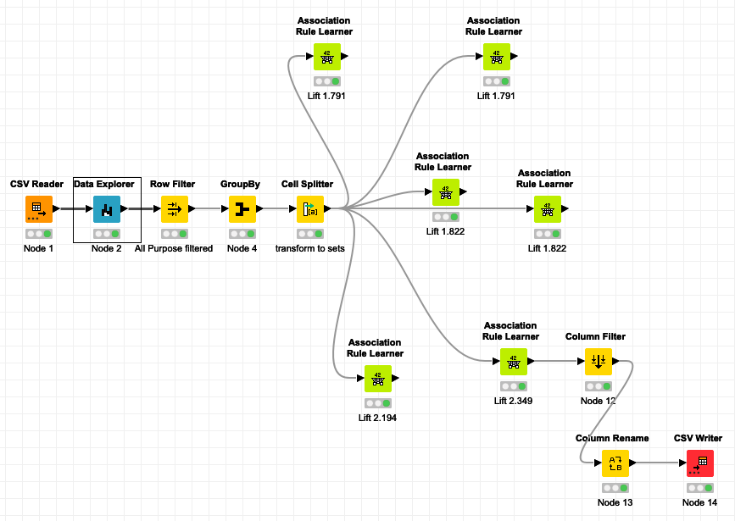
Workflow image
KNIME workflow:
1. Data Explorer:
Basic EDA of all parameters.
2. Row Filter:
To filter the “All-Purpose” value since this looks not relevant.
3. GroupBy :
Grouped by Order ID
4. Cell Splitter:
Transformed the Product Data to set.
5. Association Rule Learner:
Market Basket Analysis to generate the Frequent/Item List.
6. Hyper tuned
with confidence and support for better Lift Value.
7. Rename & Export

Slide 19
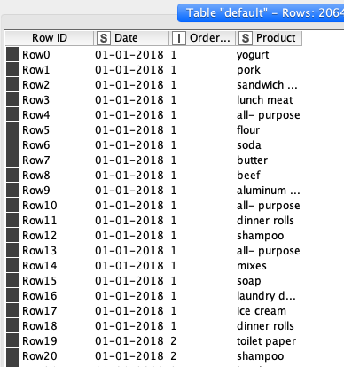
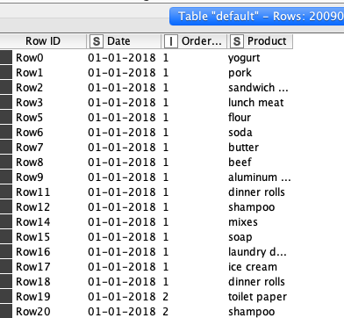
Insights:
All Purpose is general product so we Filtered the data to get better combos
BUY
SELL
Raw Data
Filtered Data
20641
20090

Slide 20
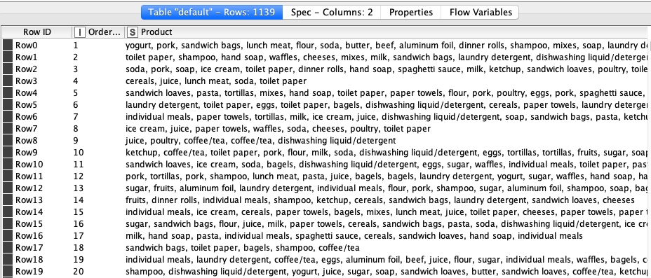
Group By:
In this node
Duplicated products and concatenated them in a single group as per the purchase or order ID.
1139

Slide 21
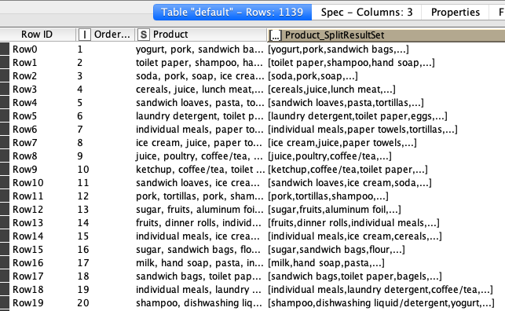
4. Cell Splitter:
Transformed Products to Set
This again helped us to classify the items in the set format.
1139

Slide 22
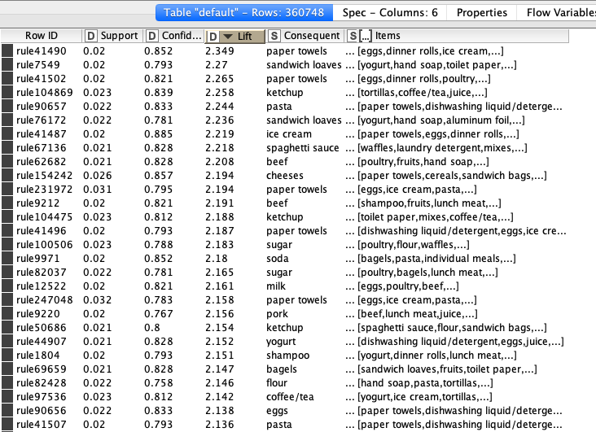
6. Associate Rule Learner
Hyper tuned with confidence and support for better Lift Value.
we added a value to our Support which is between 0-1.
We added value of 0.02 that is 2% sell of a product from overall transactions.
We also selected the association rule for the minimum confidence as 0.06.
Lift :
Higher lift value we recommend that product to the customer
1139

Slide 23
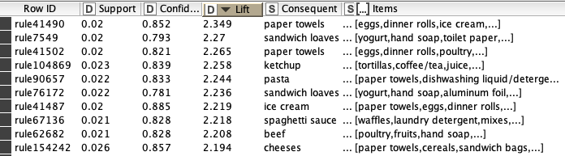
Inference
Recommendation
Based on Association rule learner ; whichever has a higher lift value , can recommend that product to the customer.
Consequent column contains recommended products.
And we have sorted the lift values from higher to lower for the better recommendations.
Though Lift is higher with Support = 3% and confidence as 0.05, but Lift with Support = 2% and confidence as 0.06 gave better recommendation.
Since Paper towel, Sandwich loaves and ketchup are the most sold items, we can keep a rack near sales counter or billing counter; it would eventually increase the sale
We can have frequent sale offer on the least sold products to increase its sales
by providing special offers, discount coupon to increase the frequency of the customers.

Slide 24
Tableau Link
https://public.tableau.com/app/profile/thilak5189/viz/MRA_Milestone_2MBA/Product?publish=yes
MBA output
Thank You!.

